Slide 1

Drowsiness detection using OpenCV
By (#batch no. 15)
V.VISHESHKUMAR (16881A12C0)
K.MANUDEEP (16881A1292)
B.BHUPAL RAJU (16881A1273)
Project Supervisor :
Dr. k. Dhana Sree Devi
Associate Professor
Department of IT
Department of Information Technology
VARDHAMAN COLLEGE OF ENGINEERING, HYDERABAD
An autonomous institute, affiliated to JNTUH

Slide 2
CONTENT
Sleepy Driving Can Be Deadly
View Point
Components Required
Facial Landmark Detection
EAR Calculations
Process
Experiments and Results
Libraries Used To Develop The Algorithm
Advantages

Slide 3
“Sleepy Driving Can Be Deadly”
This is the main motivation for our project
Yet there are many approaches to solve this issue we choose the most reliable method, which gives possibly the best results when compared with the other methods.

Slide 4
View Point:
The initial step to this problem is,
To determine how long a given person’s eyes have been closed for.
If the eyes have been closed for a certain amount of time, then we’ll assume that they are starting to doze off and play an alarm to wake them up and grab their attention.

Slide 5
Components Required:
In order to implement drowsy driver detection in the real time environment we use,
webcam
processor
Alarm(buzzer)

Slide 6
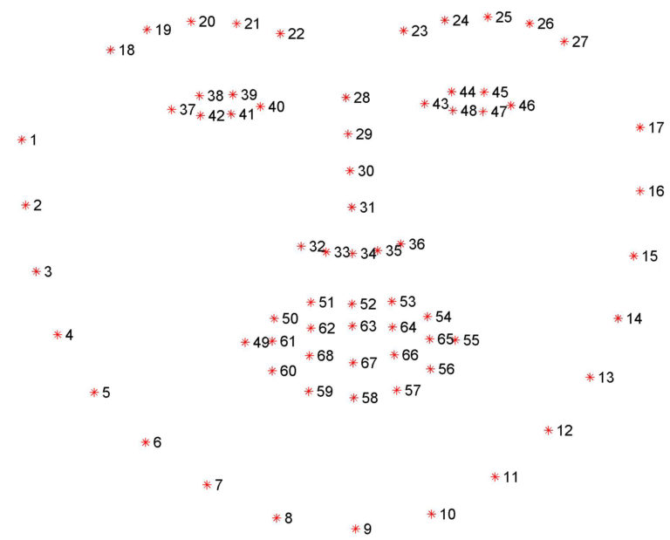
Facial Landmark Detection

Slide 7
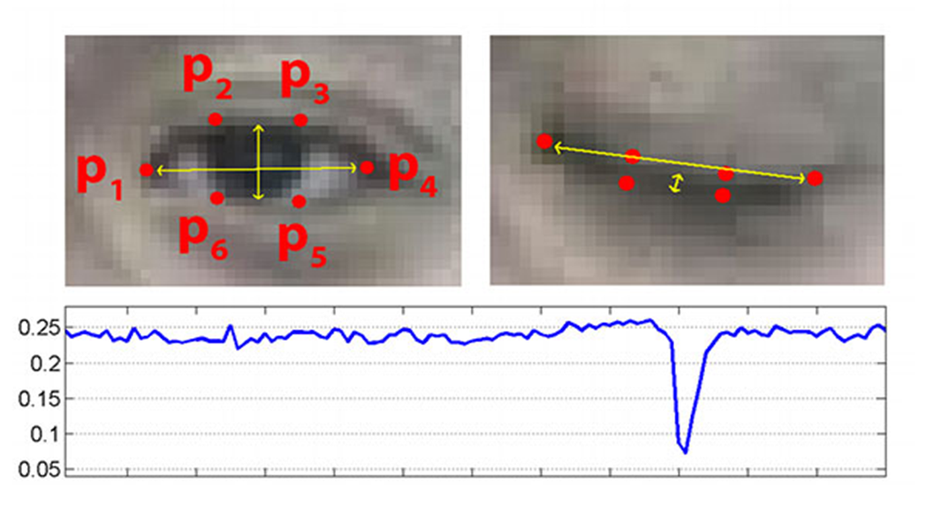
EAR Calculations:
The Eye Aspect Ratio of a person’s eye

Slide 8
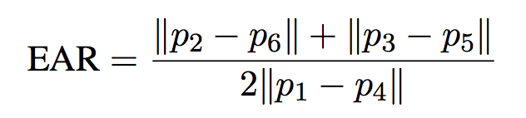
Formula:
Based on the work by Soukupová and Čech in their 2016 paper
Where p1, …, p6 are 2D facial landmark locations.

Slide 9
Process:
Compute the eye aspect ratio to determine if the eyes are closed
If the eye aspect ratio indicates that the eyes have been closed for a sufficiently long enough amount of time, we’ll sound an alarm to wake up the driver
The eye aspect ratio is approximately constant while the eye is open, but will rapidly fall to zero when a blink is taking place
If the value falls but does not increase again, thus implying that the person has closed their eyes.

Slide 10
Process:
Open Anaconda prompt.
Then activate Anaconda environment.
Set the path of the execution file.
C:\Users\vishesh\Desktop\project major\Dowsiness Detection\drowsiness-detections.
Execute the file by python detect_drowsiness.py –shape-predictor shape_predictor_68_face_landmarks.dat –alarm alarm.wav

Slide 11
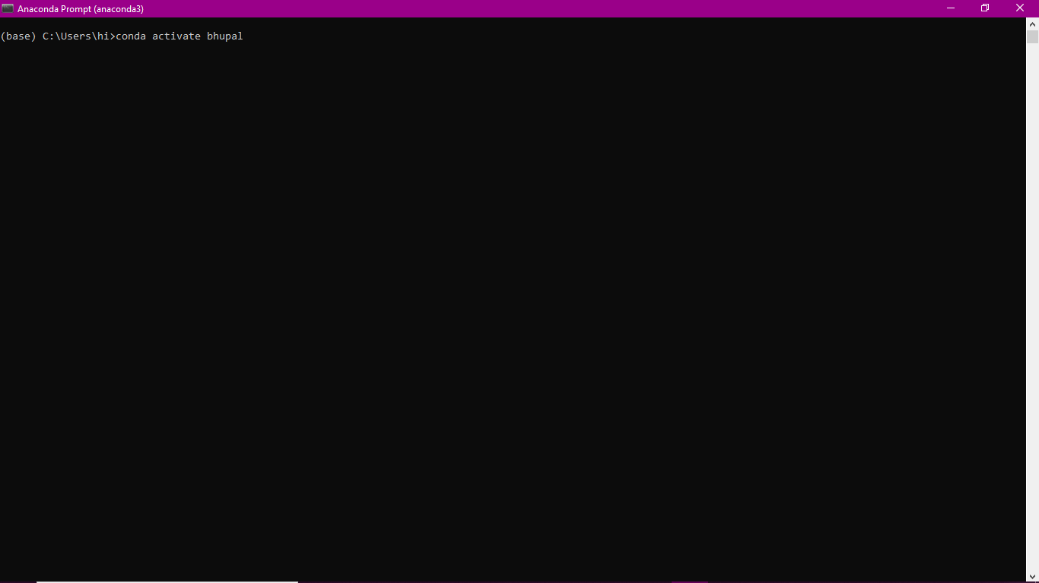
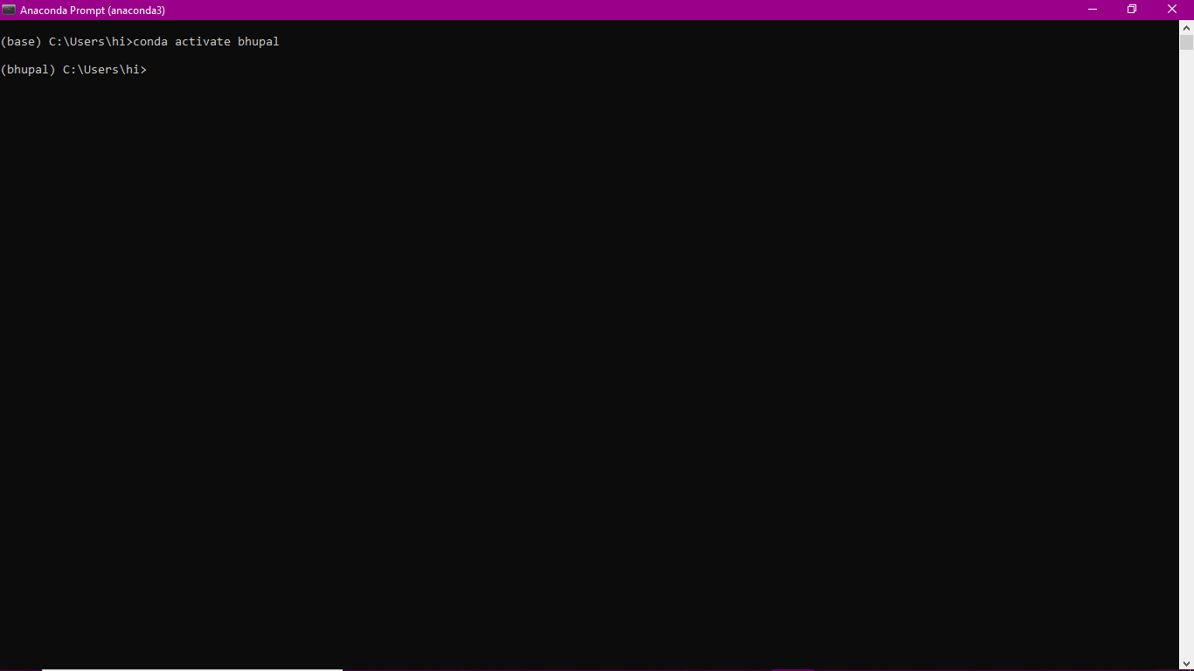
Experiments and Results

Slide 12
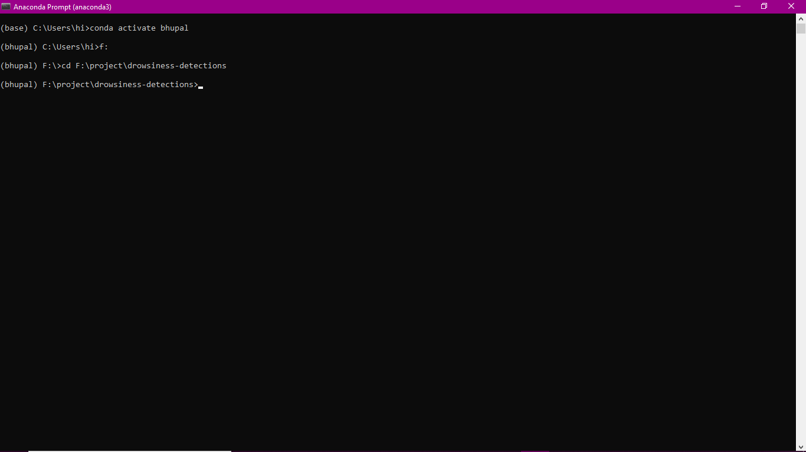
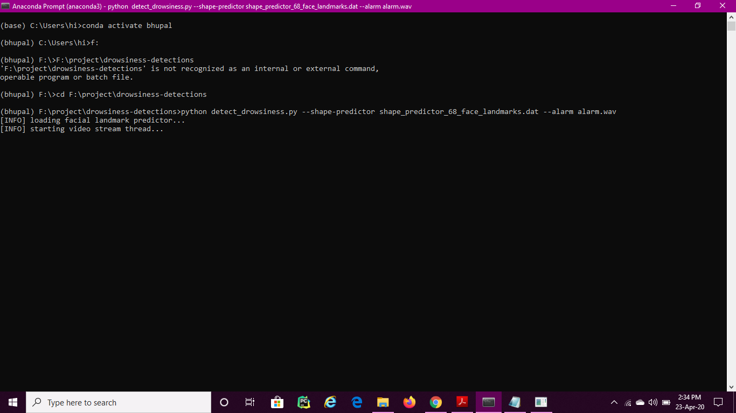
Experiments and Results

Slide 13
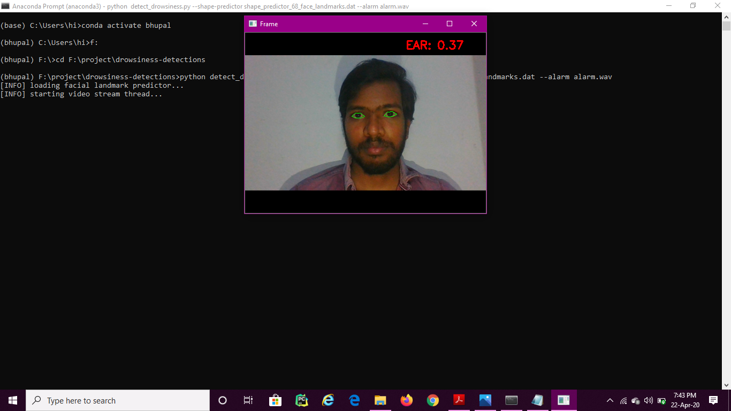

Experiments and Results

Slide 14
Libraries Used To Develop The Algorithm:
openCV
dlib
python
play sound
threading
imutils
scipy
numpy

Slide 15
Advantages:
The eye aspect ratio is a much more elegant solution that involves a very simple calculation based on the ratio of distances between facial landmarks of the eyes.
This method for eye blink detection is fast, efficient, and easy to implement.
Using this simple equation, we can avoid image processing techniques and simply rely on the ratio of eye landmark distances to find if the person is sleeping or not

Slide 16


